Slide 1
The Bald Truth about Androgenetic Alopecia

Slide 5
The Bald Truth about Androgenetic Alopecia
(Aka Male/Female Pattern Balding)

Slide 6
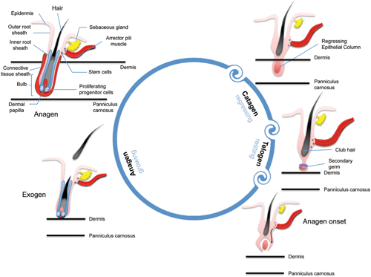

Slide 7
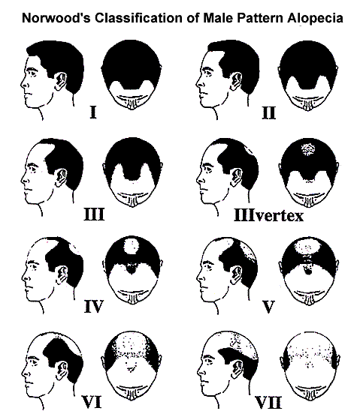

Slide 8
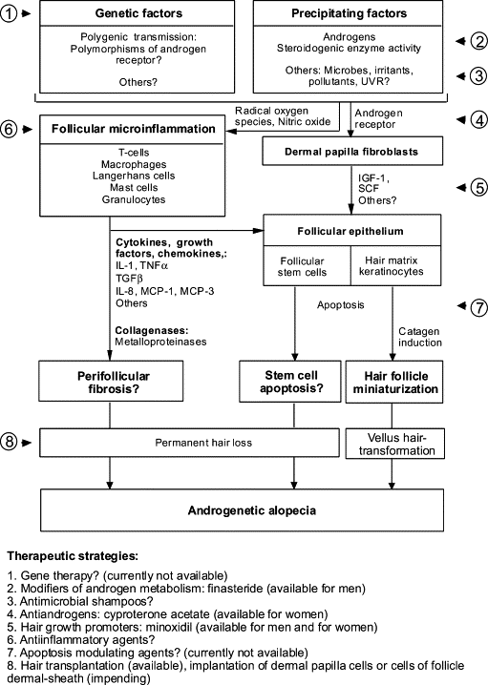

Slide 9
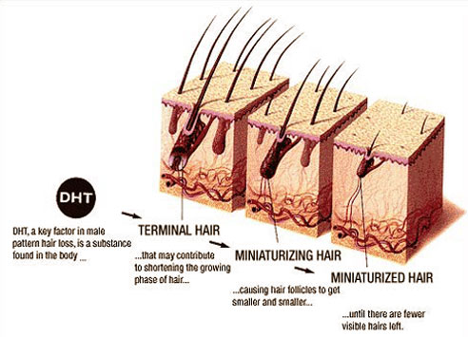
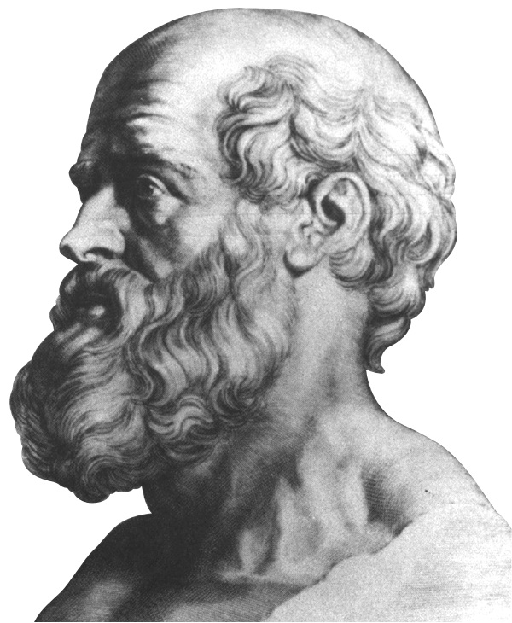

Slide 15
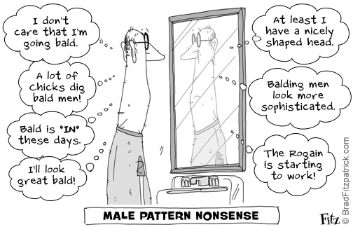

Slide 16
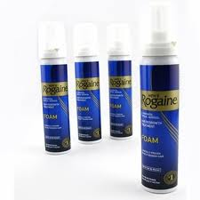
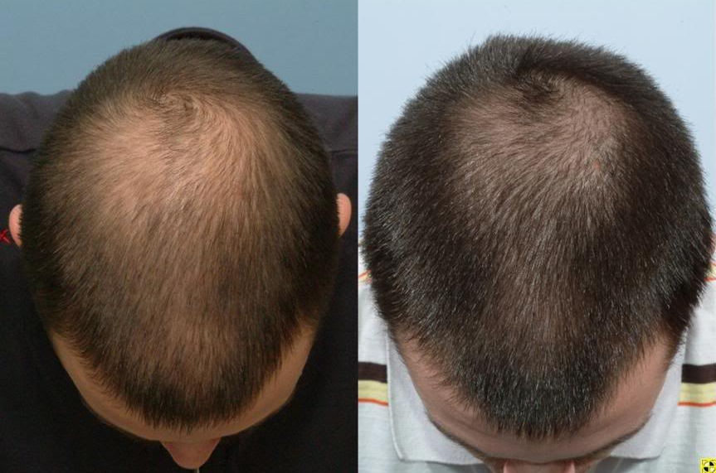
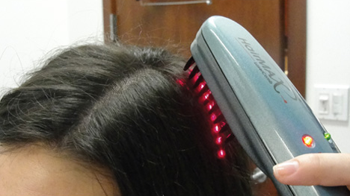

Slide 17
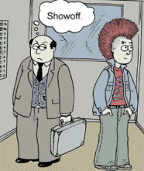

Slide 18
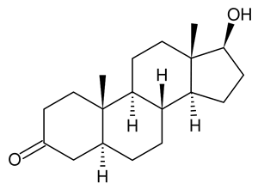

Slide 19
This Concludes: The Bald Truth about Androgenetic Alopecia

Slide 20
References
Trueb RM. Molecular mechanisms of Androgenetic alopecia. Experimental Gerontology. 2002 Aug 9; 37(8-9); 981-990. Available from: http://www.sciencedirect.com.offcampus.lib.washington.edu/science/article/pii/S0531556502000931
Shamsaldeen OS, Mubki TA, Shapiro J. Topical Agents for Hair Growth Promotion: What is Out There? Skin Therapy Letter [Internet]. 2013 May 28. Available from: http://www.skintherapyletter.com/2013/18.4/2.html
Chin EY. Androgenetic alopecia (male pattern hair loss) in the United States: What treatments should primary care providers recommend? Journal of the American Association of Nurse Practitioners. 2013 May 7; 25(8); 395-401. Available from: http://onlinelibrary.wiley.com/doi/10.1111/1745-7599.12030/full
Levy LL, Emer JJ. Female pattern alopecia: current perspectives. International Journal of Women’s Health [Internet]. 2013 Aug 29; 2013 (5); 541-556. Available from: http://www.ncbi.nlm.nih.gov/pmc/articles/PMC3769411/#__ffn_sectitle
Musa R. Folk Remedies for Alopecia. Clinics in Dermatology. 2013 Jul-Aug; 31(5); 498-500. Available from: http://www.sciencedirect.com/science/article/pii/S0738081X13000679
Nonomura Y, Otsuka A, Inui S, Miyachi Y, Kabashima K. Female pattern hair loss possibly caused by tamoxifen: Androgen receptor expression in the outer root sheath in the affected area. The Journal of Dermatology [Internet]. 2012 Aug 20; 39(12); 1060-1061. Available from: http://onlinelibrary.wiley.com/doi/10.1111/j.1346-8138.2012.01632.x/full
Tabolli S, Sampogna F, Pietro C, Mannooranparampil TJ, Ribuffo M, Abeni D. Health Status, Coping Strategies, and Alexithymia in Subjects with Androgenetic Alopecia. Am J Clin Dermatol [Internet]. 2013 Feb 15; 14; 139-145. Available from: http://web.a.ebscohost.com.offcampus.lib.washington.edu/ehost/pdfviewer/pdfviewer?sid=577064d3-31aa-4a1d-9a29-f136f750bacf%40sessionmgr4002&vid=2&hid=4107
Avci P, Gupta G, Clark J, Wikonkal N, Hamblin M. Low-level laser (light) therapy (LLLT) for treatment of hair loss. Lasers in Surgery and Medicine [Internet]. 2013 Aug 23. Available from: http://onlinelibrary.wiley.com/doi/10.1002/lsm.22170/citedby
Su L, Chen L, Lin S, Chen H. Association of Androgenetic Alopecia With Mortality From Diabetes Mellitus and Heart Disease. JAMA Dermatol. 2012 December 30; 149(5); 601-606. Available from: http://archderm.jamanetwork.com/article.aspx?articleid=1688048#ArticleInformation
Fillon M. Researchers Link Early Hair Loss and Prostate Cancer. JNCI. 2013 Aug 16; 105(17); 1258-1259. Available from: http://jnci.oxfordjournals.org/content/105/17/1258.long

Slide 21
Questions?

